Slide 1

Win 8 Apps with HTML5
By
Sam Nasr, MVP, MCAD, MCTS
Nasr Information Systems
February 26, 2014

Slide 2
Introduction
Sam Nasr (sam@nasr.info)
Software developer since 1995
Independent Software Consultant (Nasr Information Systems)
MCAD, MCT, MCTS(WSS/MOSS)
President - Cleveland C#/VB.Net User Group
President – Cleveland WPF User Group
President - .Net Study Group
INETA Mentor for Ohio
INETA Community Champ (2010, 2013)
Author for Visual Studio Magazine
Microsoft Most Valuable Professional (2013)

Slide 3
Housekeeping
Bathrooms
Vending Machines
Forum for learning: feel free to ask questions
Cell phones on vibrate please

Slide 4
Audience Survey
Familiar with Win8 Apps?
Developed Win8 Apps?
.Net Developers?

Slide 5
System Requirements
Windows 8 RTM
Visual Studio 2013
Processor: 1 gigahertz (GHz) or faster with support for PAE, NX, and SSE2 (more info)
RAM: 1 gigabyte (GB) (32-bit) or 2 GB (64-bit)
Hard disk space: 16 GB (32-bit) or 20 GB (64-bit)
Graphics card: Microsoft DirectX 9 graphics device with WDDM driver

Slide 6
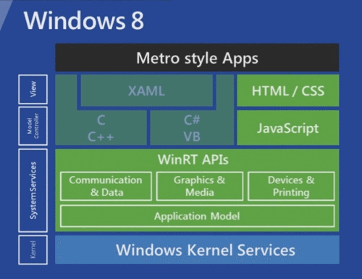


Slide 7
Web Apps vs. Win 8 Apps
Primary Differences
Cross Platform
Horizontal Scrolling

Slide 8
Primary Differences
Write-once, Run everywhere but numerous platforms with abstraction layers that are good for some, bad for others.
Recommend: unified service or data layer, but a native UI layer
Apps can be built with JS, C++, C#, XAML
Full access to WinJS

Slide 9
Cross Platform
Write-once, Run everywhere but numerous platforms with abstraction layers that are good for some, bad for others. In addition, it’s a moving layer
Recommend: unified service or data layer, but a native UI layer
Apps can be built with JS, C++, C#, XAML
Full access to WinJS

Slide 10
Horizontal Scrolling
Matches most languages for reading direction (books, magazines, newspapers)
More screens are landscape than portrait
Generally less content per view, not tons and tons of info
Enhanced support for touch, even for for 30 touch point monitors

Slide 11
Why Native vs. Web?
Leverage full capabilities of device locally
Less server round-trips for better performance.
IETestDrive.com shows speed of hardware acceleration
Native contracts (swipe for charms, touch on search/share work the same for all apps guaranteed)
User data and local access
Program Lifecycle Management (start, pause, exit event handling)

Slide 12
Win App Design Traits
Content before chrome
Fast and Fluid
Snap and scale beautifully
Use the right contracts
Invest in a great tile
Feel connected & alive
Roam to the cloud
Embrace Windows Design Principles

Slide 13
Project Traits
Support for .HTML, .CSS, .JS
Package.appxmanifest – XML file but VS displays in a nice UI for editing
Reference to Microsoft.WinJS.1.0.appx, CSS, JS
ProjectName_TemporaryKey.pfx: temporary manifest key file for ClickOnce deployment
Debug mode will drill into JS for stack trace information
Default.html references all page controls and is essentially a single page model.

Slide 14
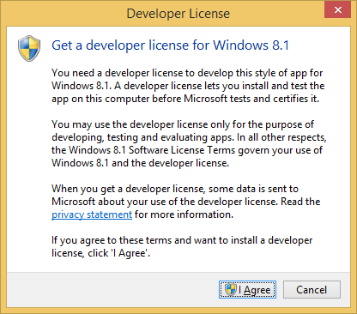
Developer License

Slide 15
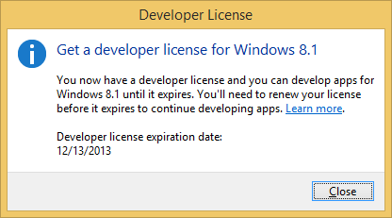
Developer License

Slide 16
data- Attributes
<div data-firstname="David" id="fName">
var div = getElementById("fName");
var fn = div.dataset("firstname");

Slide 17
Controls
Data-win-control attributes
Data-win-options attribute
<div id=”rater”
Data-win-control=”WinJS.UI.Rating”
Data-win-options =”{maxRating:3}”>
</div>

Slide 18
Demo
Templates & tools

Slide 19
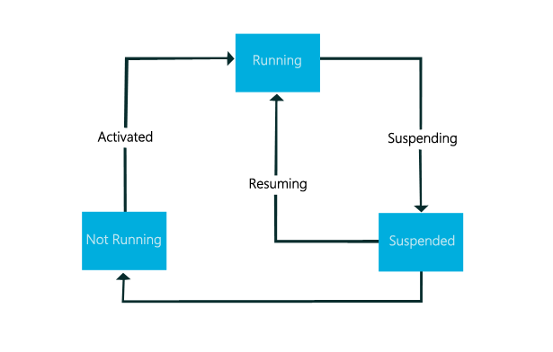
Lifecycle

Slide 20
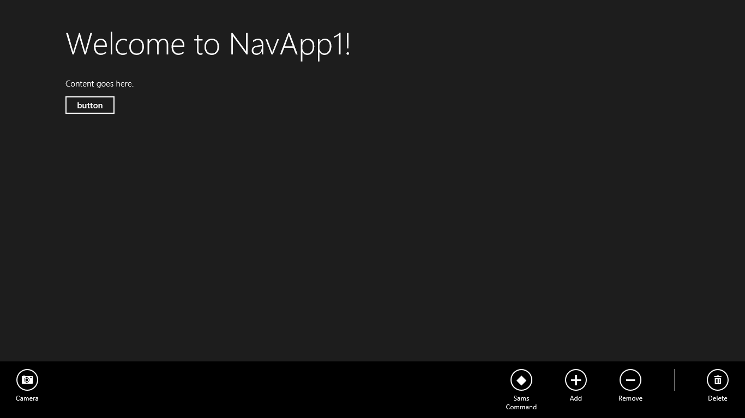
App Bar

Slide 21
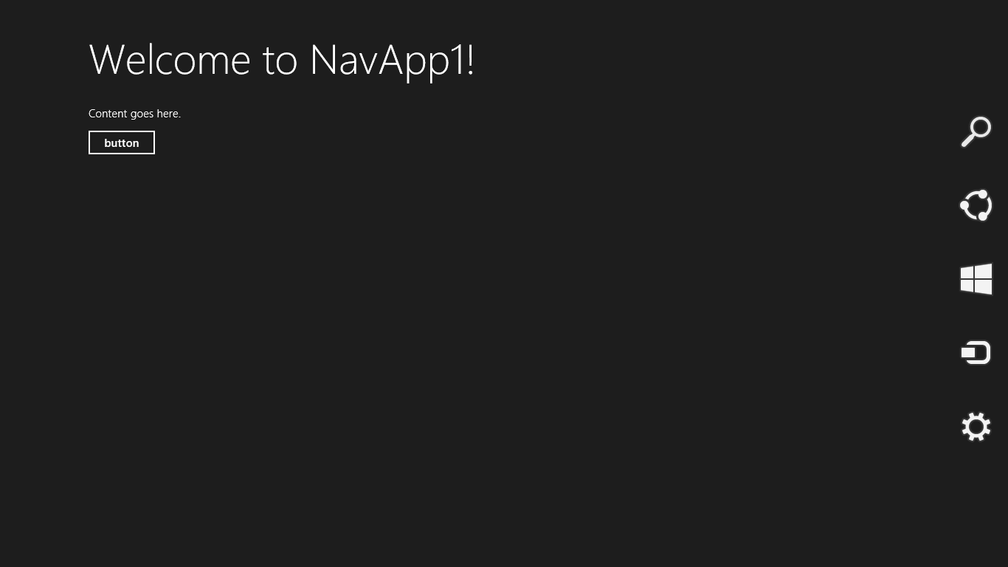
Charms Bar

Slide 22
Contracts
Searching
Sharing
Settings
FilePicker
PlayTo

Slide 23
Sharing
Text
Rich Text
HTML
URI
File
Image
Custom

Slide 24
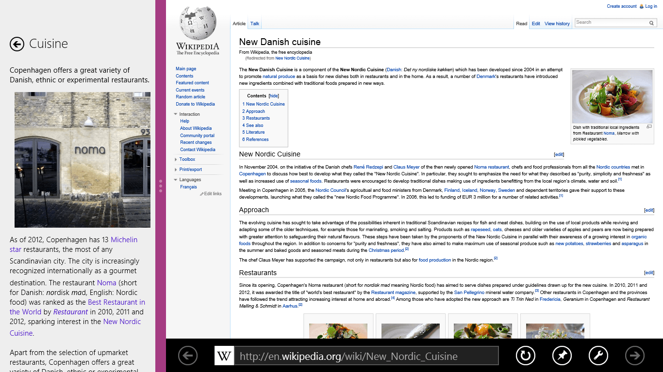
Snapping

Slide 25
Snapping
Account for the app bar when snapped
A few pixels must separate snapped apps
An app can blocked from going into portrait
Images are loaded automatically from the naming convention
<img src=”projector.jpg” width=80px height=80px />
  Projector.scale-100.jpg
  Projector.scale-140.jpg
  Projector.scale-180.jpg
Notes:
Yes, an app can be made that doesn’t support snap

Slide 26
WinJS.UI Objects
WinJS.UI.DatePicker
WinJS.UI.FlipView
WinjS.UI.ListView
WinJS.UI.Rating controls
WinJS.UI.BackButton

Slide 27
Demo
Win Objects

Slide 28
Recap
System Requirements
Why Native vs. Web
Templates
Win8 App Design Traits
IDE Features

Slide 29



Contact Info
  sam@nasr.info
http://ClevelandDotNet.blogspot.com
@SamNasr
http://www.linkedin.com/in/samsnasr
http://speakerrate.com/samnasr
Thank you for attending!

